Slide 1

Data Link Layer Unit-III

Slide 2
Data Link Layer:
Data Link Layer is second layer of OSI Layered Model.
This layer is one of the most complicated layers and has complex functionalities and liabilities.
Data link layer hides the details of underlying hardware and represents itself to upper layer as the medium to communicate.
Data link layer works between two hosts which are directly connected in some sense.
The main responsibility of the Data Link Layer is to transfer the datagram across an individual link.
The Data link layer protocol defines the format of the packet exchanged across the nodes as well as the actions such as Error detection, retransmission, flow control, and random access.
The Data Link Layer protocols are Ethernet, token ring.

Slide 3
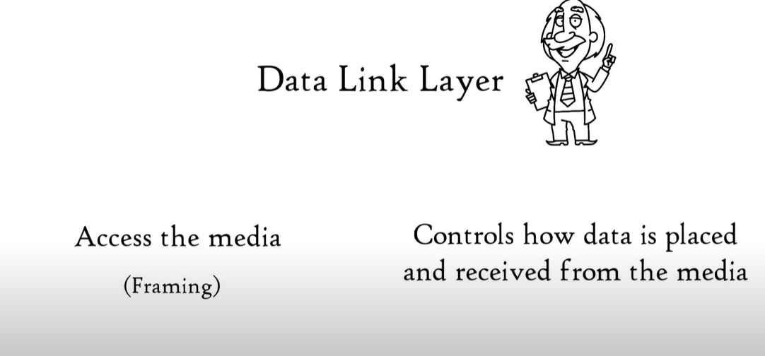
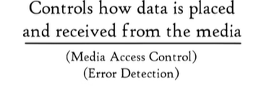

Slide 4
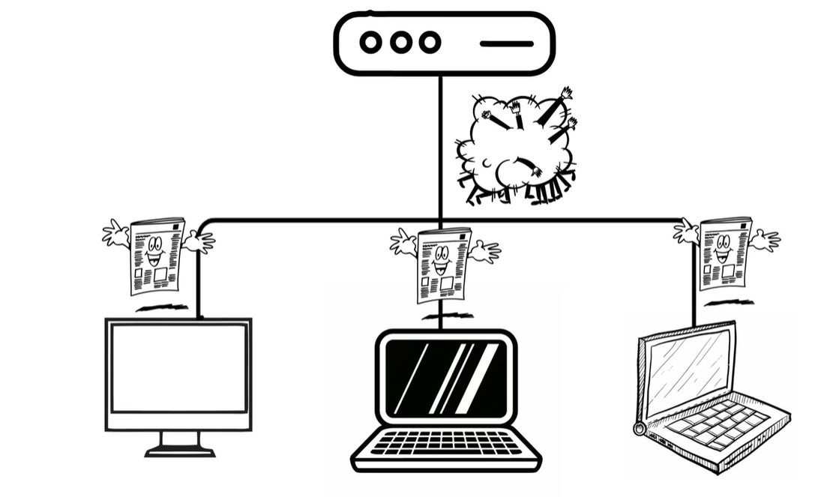
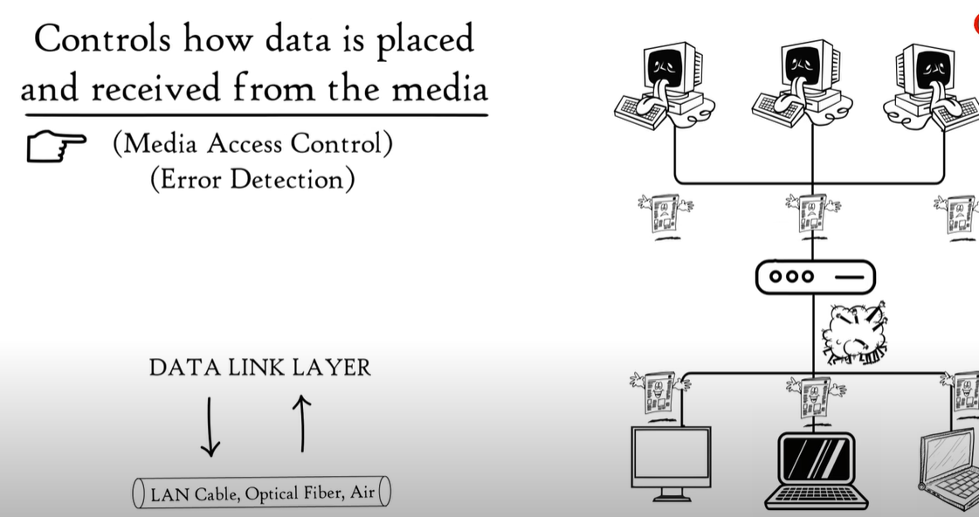

Slide 5
Sub-Layers:
Logical Link Control (LLC): This sublayer of the data link layer deals with multiplexing, the flow of data among applications and other services, and LLC is responsible for providing error messages and acknowledgments as well.
Media Access Control (MAC): MAC sublayer manages the device’s interaction, responsible for addressing frames, and also controls physical media access.
The data link layer receives the information in the form of packets from the Network layer, it divides packets into frames and sends those frames bit-by-bit to the underlying physical layer.

Slide 6
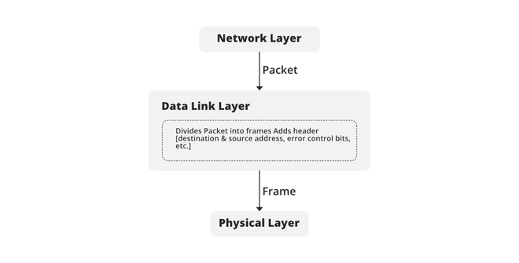
Functionality:

Slide 7
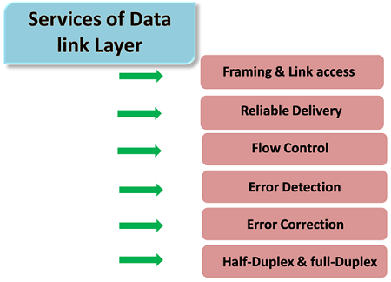
Services On Data Link Layer:

Slide 8
Framing:
The packet received from the Network layer is known as a frame in the Data link layer.
At the sender’s side, DLL receives packets from the Network layer and divides them into small frames, then, sends each frame bit-by-bit to the physical layer.
It also attaches some special bits (for error control and addressing) at the header and end of the frame.
At the receiver’s end, DLL takes bits from the Physical layer organizes them into the frame, and sends them to the Network layer.

Slide 9
Addressing:
The data link layer encapsulates the source and destination’s MAC address/ physical address in the header of each frame to ensure node-to-node delivery.
MAC address is the unique hardware address that is assigned to the device while manufacturing.
Error Control:
Data can get corrupted due to various reasons like noise, attenuation, etc.
So, it is the responsibility of the data link layer, to detect the error in the transmitted data and correct it using error detection and correction techniques respectively.
DLL adds error detection bits into the frame’s header, so that receiver can check received data is correct or not.
Flow Control:
If the receiver’s receiving speed is lower than the sender’s sending speed, then this can lead to an overflow in the receiver’s buffer and some frames may get lost.
So, it’s the responsibility of DLL to synchronize the sender’s and receiver’s speeds and establish flow control between them.

Slide 10
Access Control:
When multiple devices share the same communication channel there is a high probability of collision,
So it’s the responsibility of DLL to check which device has control over the channel and CSMA/CD and CSMA/CA can be used to avoid collisions and loss of frames in the channel.
Error detection:
Errors can be introduced by signal attenuation and noise.
Data Link Layer protocol provides a mechanism to detect one or more errors.
This is achieved by adding error detection bits in the frame and then receiving node can perform an error check.
Error correction:
Error correction is similar to the Error detection, except that receiving node not only detect the errors but also determine where the errors have occurred in the frame.
Half-Duplex & Full-Duplex:
In a Full-Duplex mode, both the nodes can transmit the data at the same time.
In a Half-Duplex mode, only one node can transmit the data at the same time.

Slide 11
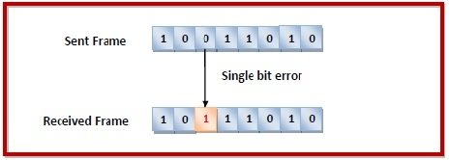
Types of Error on DLL:
Errors can be of three types, namely single bit errors, multiple bit errors, and burst errors.
Single bit error:
In the received frame, only one bit has been corrupted, i.e. either changed from 0 to 1 or from 1 to 0.

Slide 12
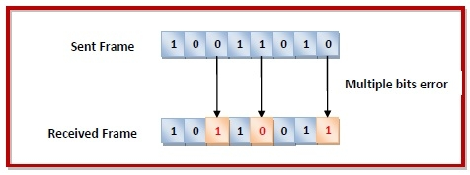
Multiple bits error
In the received frame, more than one bits are corrupted.

Slide 13
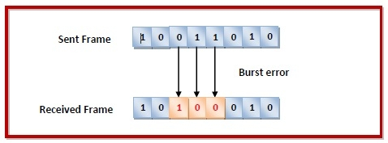
Burst error
In the received frame, more than one consecutive bits are corrupted.

Slide 14
Error Detection Techniques:
Simple Parity Check
Two-dimensional Parity Check
Checksum
Cyclic Redundancy Check
Error Detecting Codes:
Implemented either on Data Link Layer or Transport Layer:
Whenever a message is transmitted, it may get scrambled by noise or data may get corrupted. To avoid this, we use error-detecting codes which are additional data added to a given digital message to help us detect if any error has occurred during transmission of the message.

Slide 15
Error Detection Techniques:

Slide 16
Vertical Redundancy Check (Parity Check)
Least expensive method.
Even parity : A redundant bit, called a parity bit, is appended to every data unit so that the total number of 1s in the unit becomes even.
Odd parity: total number of 1s should become odd.

Slide 17
Even parity VRC concept

Slide 18
Performance:
VRC can detect all single-bit errors.
It can also detect burst errors as long as the total number of bits changed is odd.

Slide 19
Longitudinal Redundancy Check (LRC)
A block of bits is organized in a table (rows and columns).
Then calculate parity bit for each column and create a new row, which are parity bits for the whole block.

Slide 20
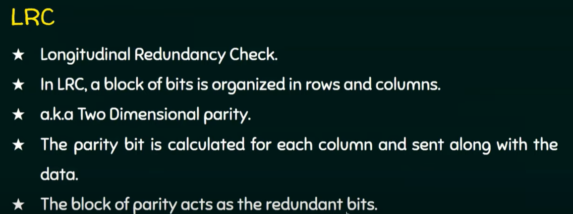

Slide 21
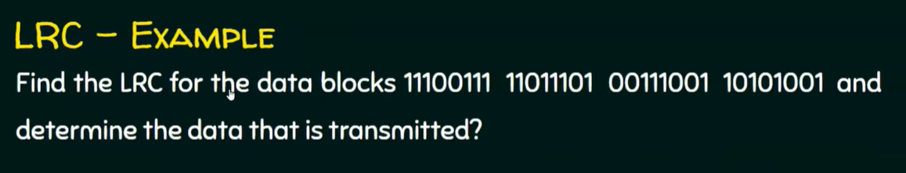
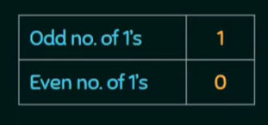
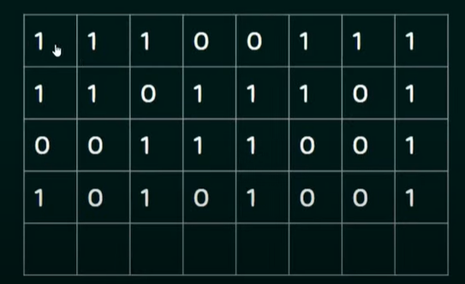



Slide 22
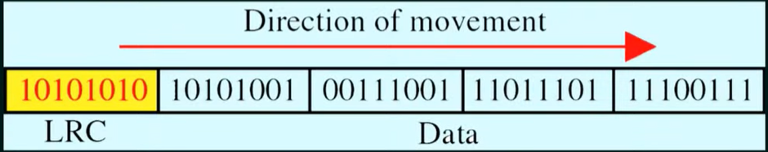

Slide 23
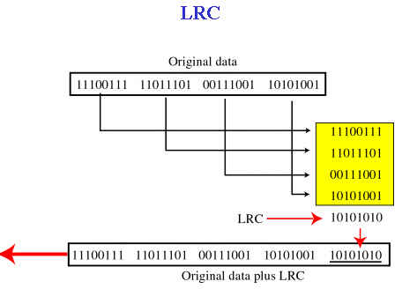

Slide 24
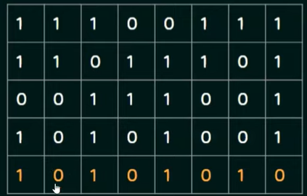
Performance:
LRC of n bits can easily detect a burst error of n bits.
A burst error of more than n bits is also detected by LRC with a high probability.
Example: if 2 bits in one data unit are damaged, and 2 bits in exactly the same position in another data unit are damaged, the LRC checker will not detect the error.

Slide 25
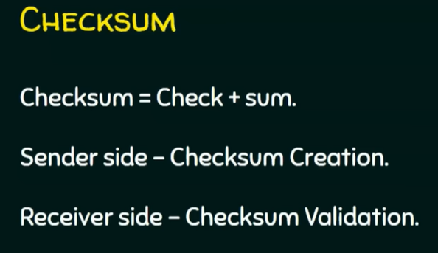

Slide 26
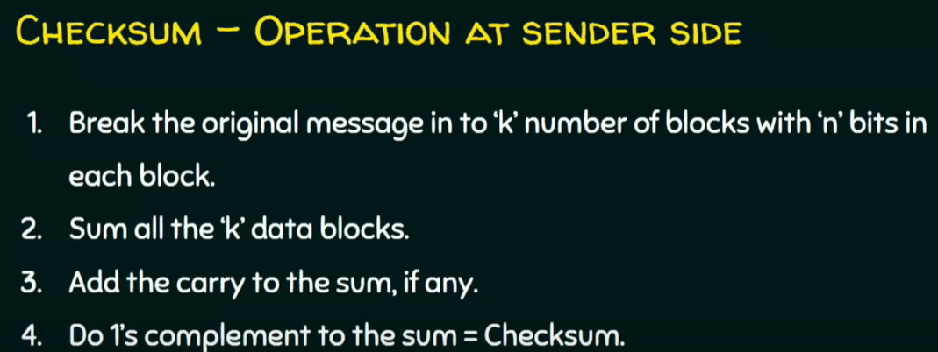

Slide 27
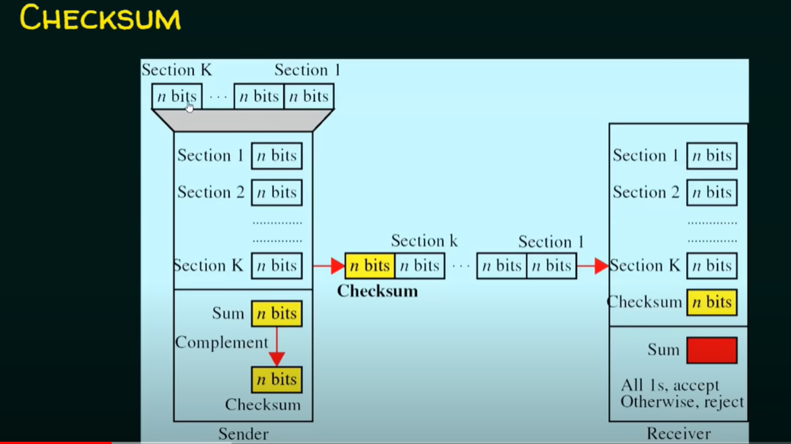

Slide 28
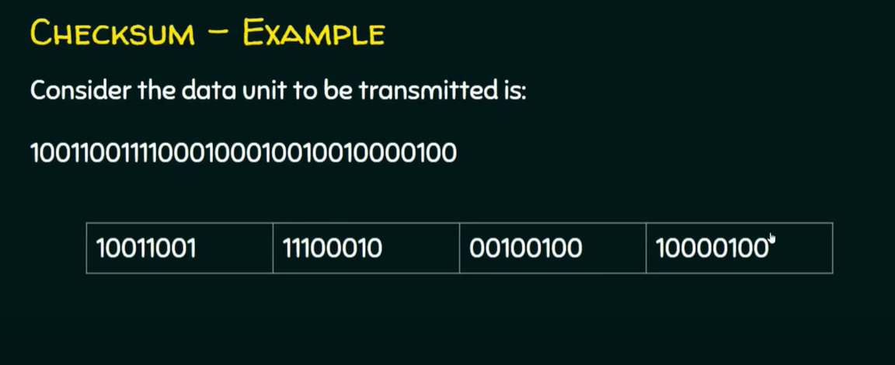

Slide 29
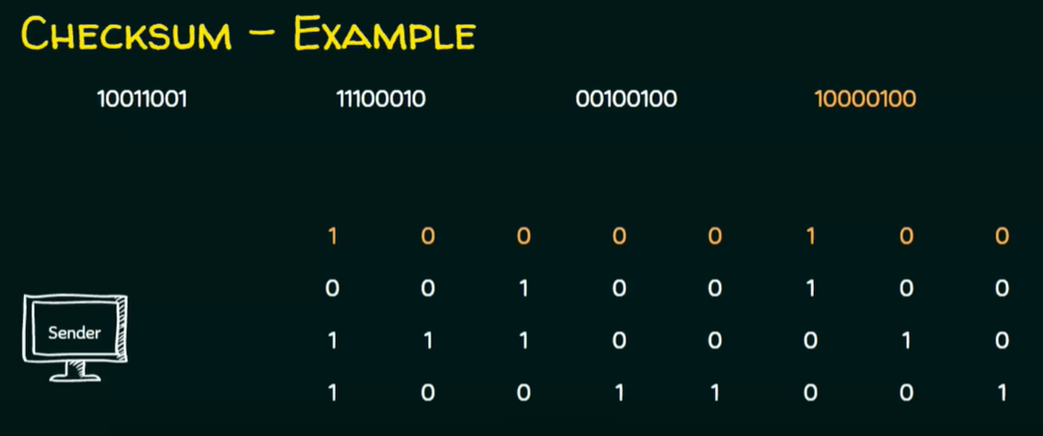
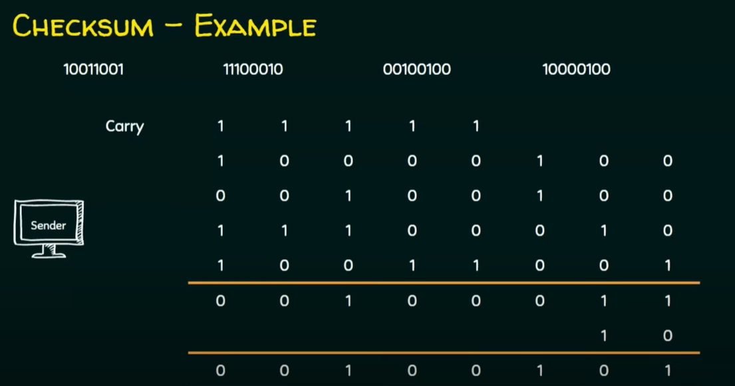
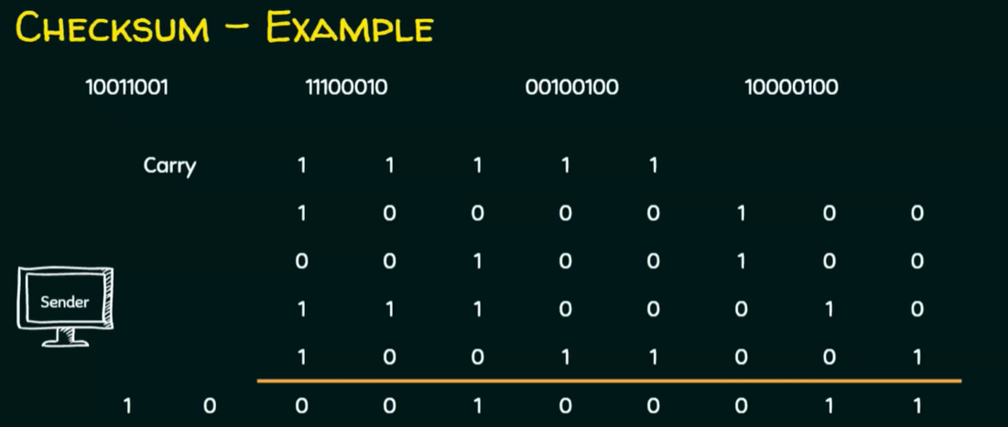

Slide 30
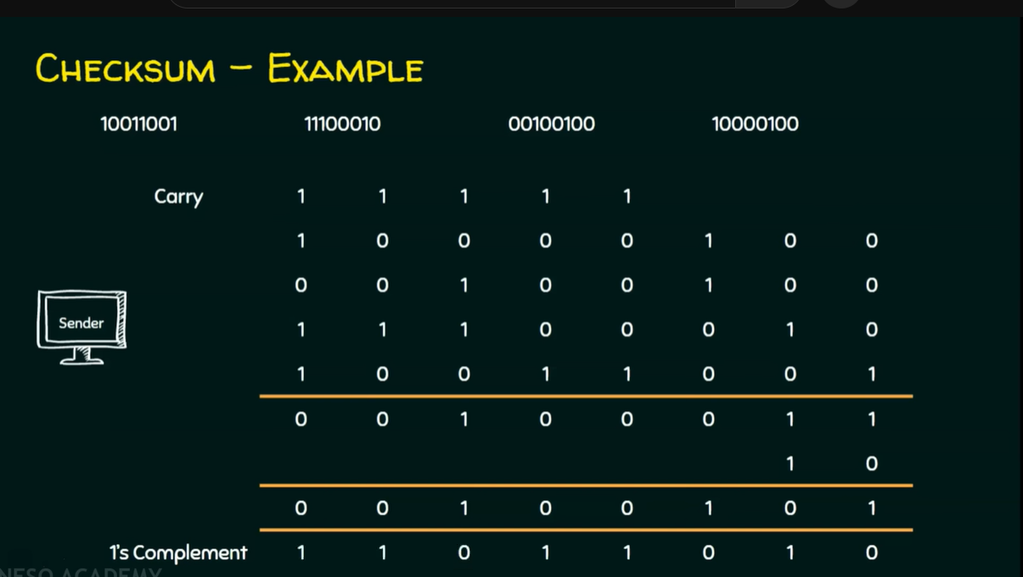

Slide 31
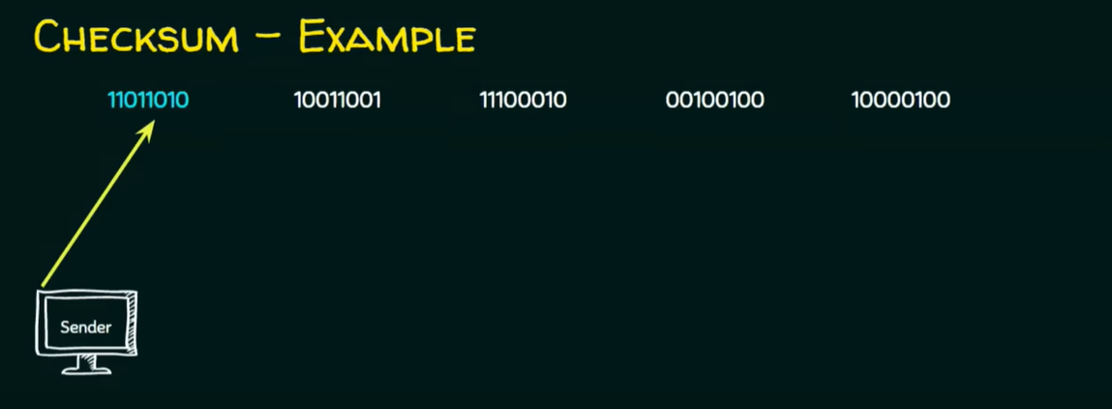

Slide 32
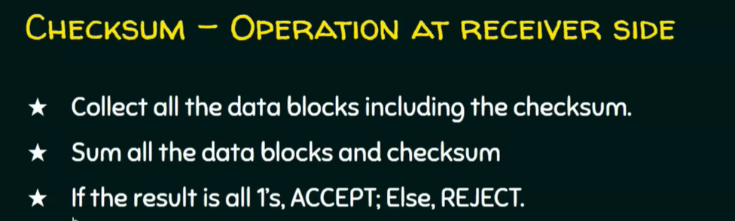

Slide 33
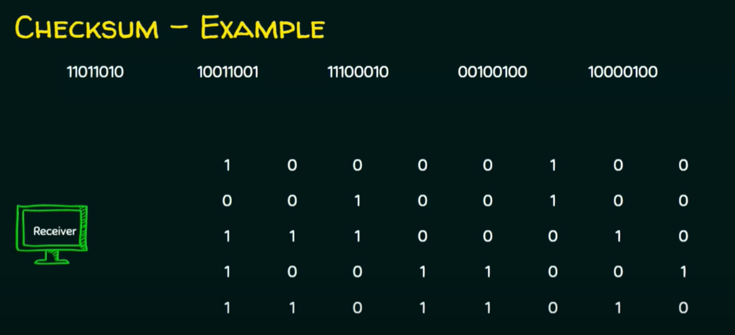
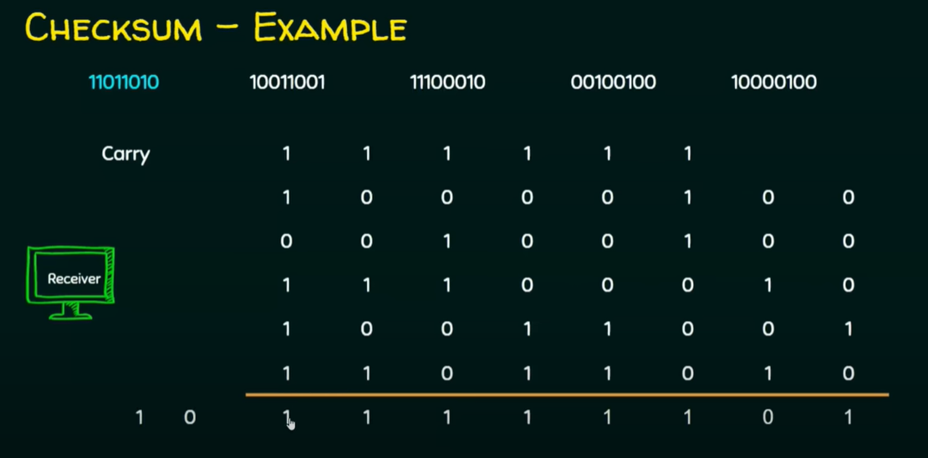

Slide 34
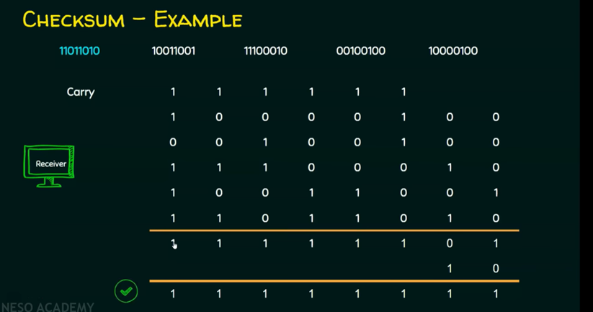

Slide 35
Cyclic Redundancy Check (CRC)
Most powerful redundancy checking technique.
Unlike VRC and LRC, which are based on addition-, CRC is based on binary division.
A CRC or CRC remainder is appended to the end of a data unit so that the resulting data unit becomes exactly divisible by a second, predetermined binary number(divisor).
At destination, incoming data unit is divided by the same number.
If no remainder- then data unit is intact.
If there is a remainder- means data unit is damaged.
Note: a CRC must have exactly one bit less than divisor.

Slide 36
CRC

Slide 37
A string of “n” 0s is appended to the data unit. The number of n is one less than the number of bits in the predetermined divisor (which is n+1 bits).
The new data unit is divided by the divisor using a process called binary division. The remainder is the CRC.
CRC of n bits replaces the appended 0s at the end of data unit. CRC may consist of all 0s.
The data unit arrives at receiver- data first , followed by CRC. The receiver treats whole string as a unit and divides by the same divisor.
If remainder is zero - data unit is allowed to pass, else it is rejected.

Slide 38
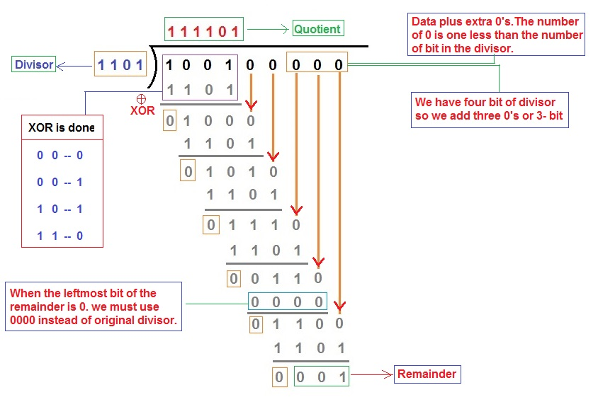
CRC

